Slide 1
IOT based Thermal Signature Detector with alarm & e-mail notification With Integrated Social distancing Screening using computer vision
Team name : GreenHolics
Team members: * Subhajit Sanyal (Team leader),
* Imran Uddin
* Rohan Chakraborty
* Jeet Hazra
GURU NANAK INSTITUTE OF TECHNOLOGY
COVID-19 Hackathon
Project Smart Screening
Department of Computer Science and Engineering(CSE)
2nd year

Slide 2
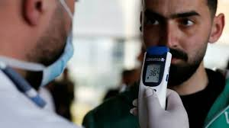
Problem Summary
The main reason of spreading of corona virus in India is people living outside this country are coming back to India.
If they are affected with covid-19 then their body temperature is higher than normal primarily.
So they are suggested to visit local hospital for further check ups and quarantine if required.

Slide 3
The total checking process of those passengers is done by human using thermal gun manually which costs almost 15,000.
If the checkers miss to check some one it may cause more spreading of corona virus. Some influential people don’t agree to go local hospital if some abnormal is detected.
Some time police don’t get complete information about the travel history about the passengers.
In the mean time getting vacant bed for the patient is heard for the affected people for the huge rush.
Some time ambulance is not available currently at that place and booking that is becomes time taken process.
Social gathering is happening every where. With 1.3 billion people it is impossible
to track them all for cops.
* We’ve also taken a stand to prevent unnessesary airport queues by allowing passengers to arrive and pass only from 2 hours before the scheduled flight timing. Our gate will allow only when the timing slot matches.

Slide 4
Scope of The Solution
We intend to solve the above problem by first integrating a thermal of detector devices with the metal detector gate .
Firstly automatic scanner device will scan the tickets to get the travel details (or they have to enter it on a touch pad) and sent to the local server for verification.
When they will approach towards the metal detector gate our thermal detector .By an ultrasonic sensor after measuring height of the passenger with the help of Servo motor the MLX-90614 sensor will be pointed right at the fore head of the passenger . If temperature is higher than normal the gate will not open and a mail will be sent to the police and the nearest local hospital with the detail information about the patient.
In order to open the gate once the police is arrived to the spot they can open it through server. Through the touch pad they can book ambulance. Just by one click location and emergency massage will be sent to the nearest ambulance service.
All the CCTV camera connected with server will have computer vision technology to detect gathering and sends video alert to police. And an app for complaint lodging
and AI gathering detection using mobile camera for common people.

Slide 5
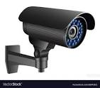
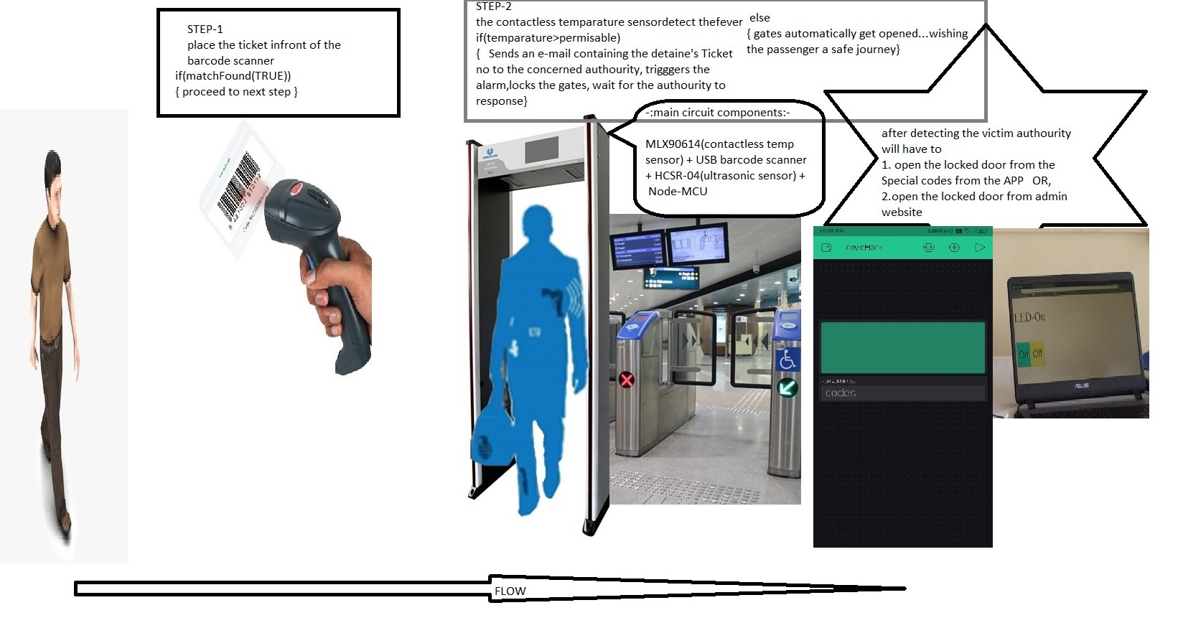
Implementation
Deep Learning based crowd counting included

Slide 6
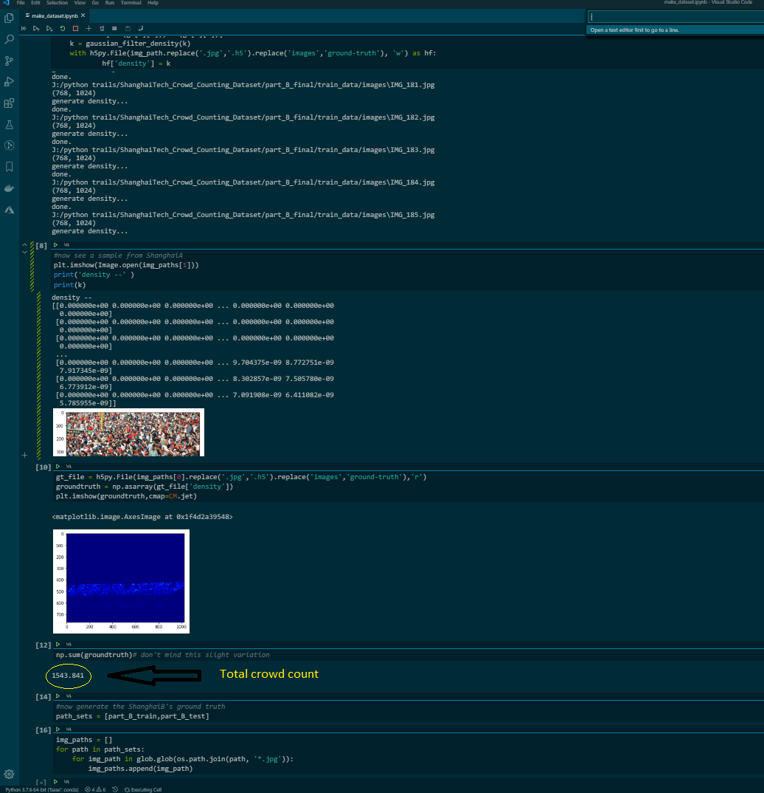
Crowd Counting Implementation
Total Crowd

Slide 7
Proposed Technogies to be Used:
Internet of things(IOT)
Cloud computing
Artificial Intelligence(AI)
Computer Vision
Proposed components to be Used:
MLX90614(Contactless temperature sensor)
USB Barcode scanner
HCSR-04(Ultrasonic sensor)
Node-MCU

Slide 8
Impact of The Solution
We intend to complete the project in three major phases, initial testing and recruitment phase, local implementation phase and large scale implementation phase.
Initial testing and recruitment phase : In this phase we will test our model prototypes and based on the testing feedback we receive, we’ll try to improve upon the model prototype.
Local implementation phase : This phase will be initiated after we have a working fully model ready. We’ll deploy it in a small scale region, say in a locality and further collect data, which will be used to further improve the project.

Slide 9
Basics Requirements of implementation: Hospitals must present a Booking record for the automatic slot reserving technique to operate seamlessly, Google maps api will be used to detect nearby hospitals from the venue.
Co-operation: Passengers must co-operate with this new system deployed.As per the needs of authourity this whole setup will be customisable with avaiable interfaces of App, web, electronic gadets , CCtv cameras etc.
Estimated cost per device:
1500(INR) approx

Slide 10
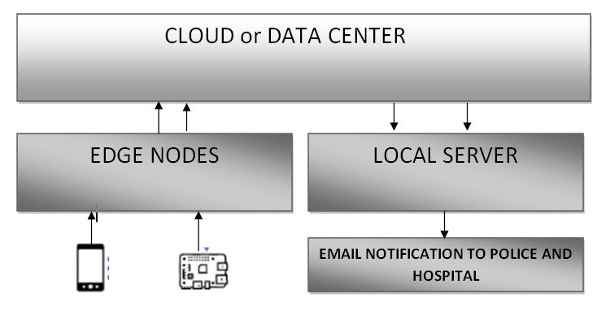

DATA FLOW

Slide 11
Challenges
Fully-Automated
No human labour required.
Availability of information to police and hospital of the effected people
Use of modern sustainable technology(IOT,AI).
Detects the probable effected people.
Sends mail to local police kiosk
Books appointment with detail information to the local dedicated hospital using mail.
Sends booking massage with location to nearest ambulance service in one click.
Real time gathering tracking and informs police.
Every human life is important. Project Smart Screening makes sure of that.

Slide 12
THANK YOU

